Slide 1
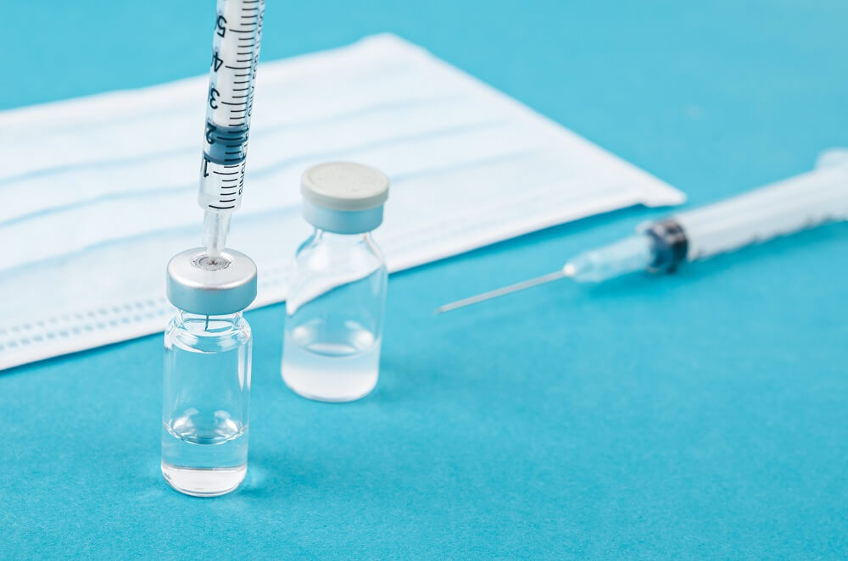
HPV AND VACCINATION
DR. Somayeh Moradpanah
Professor Assistant Of Tehran University Of Medical Science

Slide 2
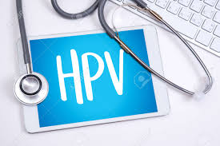
HPV
Human papillomavirus (HPV) is a sexually transmitted pathogen that causes anogenital and oropharyngeal disease in males and females.
The high-risk HPV genotypes 16 and 18 cause approximately 70 % of all cervical cancers worldwide, and types 31, 33, 45, 52, and 58 cause an additional 20 %.
HPV types 16 and 18 cause 90 % of anal cancers and oropharyngeal cancer, vulvar and vaginal cancer, and penile cancer.
HPV types 6 and 11 cause approximately 90 % of anogenital warts.

Slide 3
EPIDEMIOLOGY OF ANOGENITAL INFECTION
Globally, anogenital HPV is the most common sexually transmitted infection.
peak prevalence of HPV infection typically occurs within the first decade after sexual debut, typically between the ages of 15 to 25 years in most western countries.
It has been estimated that at least 80 percent of sexually active individuals are exposed to HPV once in their lifetime .
However, many experts believe that virtually all sexually active adults have been infected by HPV for the following reasons:
Most HPV infections are transient and can come and go in the interval between HPV testing .

Slide 4
Role of human papillomavirus —
is the major etiologic agent of cervical precancer and cancer .
HPV infection is necessary for development of cervical neoplasia, but HPV alone is not sufficient to cause these disorders.
The two major factors associated with development of high-grade CIN and cervical cancer are the subtype of HPV and the persistence of the virus.
Environmental factors (eg, cigarette smoking) and immunologic influences also appear to play a role.

Slide 5
COFACTORS IN PATHOGENESIS
Immunosuppression
HIV infection – The incidence of CIN is increased
Immunosuppressive therapy – in transplant recipients and patients with systemic lupus erythematosus
Cigarette smoking — Cigarette smoking and HPV infection have synergistic effects on the development of CIN and cervical cancer .
Herpes simplex virus and chlamydia — chlamydia , herpes simplex virus or other STDs may be a surrogate marker of exposure to HPV rather than a causal factor itself
Oral contraceptives — Long-term use of oral contraceptives a cofactor that increases the risk of cervical carcinoma in patients who are HPV-positive .

Slide 6
Types :
over 100 HPV types; approximately 40 types are specific for the anogenital epithelium .
The HPV type determines the clinical manifestations of the infection and the oncogenic potential (low or high) of the virus :
●Low-risk types, such as HPV 6 and 11, only cause low-grade lesions (CIN 1) and benign condylomatous genital warts . Overall, account for 10 percent of low-grade lesions and 90 percent of condylomatous genital warts.
●High-risk HPV types, such as 16, 18, 31, 33, 45, 52, and 58, are strongly associated with high-grade lesions (CIN 2,3) and progression to invasive cancer, although they may also be associated with low-grade lesions. HPV 16 and 18 have the highest risk of developing CIN 3 or greater and account for 25 percent of low-grade lesions, 50 to 60 percent of high-grade lesions, and 70 percent of all cervical cancers

Slide 7
respiratory papillomatosis
HPV6 , 11 and other types can also cause (incidence < 4 per 100 000 ) , warts form on the larynx or other parts of the respiratory tract with the risk of airway obstruction. RRP occurs in two forms:
juvenile onset RRP, caused by vertical transmission of HPV from mother to a susceptible child perinatally, usually in childhood
adult onset RRP, transmitted horizontally through sexual activity, with onset in young adulthood, in the third decade of life(may require surgical intervention, can be fatal as lesions become malignant).

Slide 8
Age and persistence
Most cervical HPV infections are transient and occur in young patients. Persistent infection with oncogenic HPV subtypes is a key factor in development of high-grade cervical lesions and cervical cancer , while clearance of HPV infection predicts regression of CIN .
Over 50 percent of new HPV infections are cleared in 6 to 18 months, and 80 to 90 percent will have resolved within two to five years .
It is unclear whether HPV-positive patients who become HPV-negative actually clear the virus from their bodies or retain the virus in an inactive or low-level state.

Slide 9
Age and persistence
Reason HPV persists (at least 6 to 12 months ) in some patients and not in others is poorly understood.
The likelihood of persistence is related to several factors:
●Older age – 50 percent of high-risk HPV persist in patients > 55 years of age compared with a 20 percent rate of persistence in patients < 25 .
●Duration of infection – The longer an HPV infection has been recognized, the longer it will take to clear.
●High oncogenic HPV subtype – High-oncogenic HPV subtypes are more likely to persist than low oncogenic .
After viral infection or administration of the HPV vaccine, a host immune response develops. The immunologic response is still incompletely understood; however, an adequate antibody response usually prevents reinfection with the same viral type .

Slide 10
HPV-positive results
General considerations include:
●HPV 16/18 – HPV 16 or 18 positivity is the highest risk clinical scenario and is an indication for immediate referral to colposcopy and, if combined with a high-grade squamous intraepithelial lesion (HSIL), expedited treatment with an excisional procedure .
●First positive result – a common finding and, if there is no prior HPV-positive testing, is a new infection. Most new infections will revert to a negative result within 6 to 12 months . Importantly, a subsequent negative HPV test in this setting does not mean the patient has cleared the HPV virus, but rather that the virus is dormant and below the threshold of a positive test.

Slide 11
HPV-positive results
●Recurrent positive result – Positive HPV testing may recur after reversion to HPV-negative status . Often, it is the same HPV type as a past infection, suggesting a "reactivation" from a latent infection, but it can also be a new infection.
Patients are counseled that most infections detected over the years of screening are reactivations of latent infections that are acquired at or near sexual debut . Reactivation of a latent infection could imply waning immunity, and the patient might be at increased risk of persistence. This is particularly common in immunocompromised individuals .
.

Slide 12
HPV-positive results
●Persistent positive result – Persistent HPV infection (defined as consecutively positive HPV results at least 12 months apart ) is a necessary pathogenetic step for progression to clinically relevant disease.
Patients with persistent positive results, but in whom further work-up (with cytology and colposcopic biopsies) is reassuring, are evaluated with vaginal colposcopy. If is negative, continued surveillance with cervical cytology and colposcopy is prudent as the patient remains at risk for cervical cancer .

Slide 13
The interval between the acquisition of HPV infection and progression to invasive carcinoma is usually 15–20 years or longer.
The basis for this progression is not well understood but the predisposing conditions and risk factors include the following:
HPV type; immune status ( progression time shorter in persons who are immunocompromised , HIV-infected, or receiving immunosuppressive therapy);

Slide 14
Treatment of cervical disease
There is no virus-specific treatment for HPV infection, screening and treatment of cervical precancerous lesions is highly successful in preventing cervical cancer.
Cervical precancerous lesions can be treated by ablative methods, (thermal ablation or cryotherapy), or by excisional treatment by large-loop excision of the transformation zone (LLETZ) or cold knife conization (CKC ) .

Slide 15
The US FDA approved the cobas HPV test (Roche, Indianapolis, IN), in March 2014, and the Onclarity HPV Test (Becton Dickinson, Franklin Lakes, NJ), in April 2018, for primary HPV testing for screening for patients 25 years or older.

Slide 16
What are the symptoms of HPV?

Slide 17
What are the symptoms of an HPV infection?
Some types of HPV cause genital warts.
But many people do not have any symptoms when they get infected with HPV.
in some people, the infection doesn't go away. If this happens, it can lead to problems

Slide 18
How is human papilloma transmitted?
Toilet
Swimming
vaginal sonography
Sex
vertical transmission

Slide 19
We don't have conclusive evidence showing the transmission of HPV from a person to an object and then to another person but we do have other findings that raise some concern
wet towels may responsible for some cases of HPV in young children.an infected parent may transfer virus to a towel, and shortly thereafter use the towel on their child.
Ultrasound probes including vaginal ultrasound, may become contaminated with HPV .
even some high-level disinfectants are inadequate to remove the virus. sonicated hydrogen peroxide and ultraviolet C radiation appear effective.
HPV may uncommonly be passed on via a towel or medical instrument, sharing toilet seats or swimming in a pool with an infected person appears to be safe.

Slide 20
HOW IS IT DIAGNOSED ?
IS BIOPSY IS NECESSARY?

Slide 21
DIAGNOSIS
For women:
hpv testing for 30 years and older
For men :
It’s important to note that the HPV DNA test is only available for diagnosing HPV in women. There’s currently no FDA-approved test available for diagnosing HPV in men.
routine screening for anal, mouth, throat, or penile cancer in men isn’t currently recommended

Slide 22
Does genital wart cause cancer?
The type of HPV virus that causes genital warts is different from the type of HPV virus that causes cancer

Slide 23
HOW TO PREVENT HPV?

Slide 24
PREVENTION
Safe sex
Handwashing
Regular Pap Smears
Smoking makes HPV infection more difficult to clear
vaccination

Slide 25
WHO position The priority purpose of HPV immunization is the prevention of cervical cancer, which accounts for 82% of all HPV-related cancers.
The 2020 WHO Global Strategy to Accelerate the Elimination of Cervical Cancer recommends that HPV vaccines should be included in all national immunization programmes and should reach 90% of all girls by age 15 by 2030.

Slide 26
vaccinnation
All HPV vaccines are indicated for use in females aged 9 years or older, and are licensed for use up to 26 or 45 years of age.
Some HPV vaccines are also licensed for use in males.

Slide 27
AVAILABLE VACCINES
Three different vaccines have been clinically developed:
Human papillomavirus quadrivalent vaccine (Gardasil) targets HPV types 6, 11, 16, and 18.
Human papillomavirus 9-valent vaccine (Gardasil 9) targets the same HPV types as the quadrivalent vaccine (6, 11, 16, and 18) as well as types 31, 33, 45, 52, and 58.
Human papillomavirus bivalent vaccine (Cervarix) targets HPV types 16 and 18

Slide 28
Storage of HPV vaccines All HPV vaccines should be maintained at 2–8 °C, not frozen and protected from light. They should be administered as soon as possible after being removed from the refrigerator. The shelf-life of HPV vaccines varies by product. Cervarix is stable and can be stored outside the refrigerator for up to 3 days at temperatures between 8 °C and 25 °C, or for up to 1 day at temperatures between 25 °C and 37 °C. Gardasil and Gardasil-9 are licensed to be stored for 3 days at temperatures from 8 °C to 42 °C (controlled temperature chain (CTC)) or for 4 days at temperatures from 8 °C to 40 °C

Slide 29
Bivalent HPV vaccines Cervarix
For girls and boys aged 9–14 years as a 2-dose schedule (5–13 months apart).
If the recipient’s age at the time of the first dose is ≥15 years, three doses should be given (at 0, 1–2.5 months and 5–12 months).

Slide 30
ADMINISTRATION
Indications and age range
we recommend routine HPV vaccination for all females and males in the following age ranges :
Routine HPV vaccination is recommended at 11 to 12 years. It can be administered starting at 9 years of age.
For adolescents and adults aged 13 to 26 years who have not been previously vaccinated or who have not completed the vaccine series, catch-up vaccination is recommended.

Slide 31
ADMINISTRATION
Indications and age range
For adults 27 years and older, catch-up vaccination is not routinely recommended;
the ACIP notes that the decision to vaccinate people in this age group should be made on an individual basis.
The likelihood of prior exposure to HPV vaccine types increases with age, and thus the population benefit and cost-effectiveness of HPV vaccination is lower among older patients.

Slide 32
ADMINISTRATION
Indications and age range
However, for some individuals in this age group, such as those with no prior sexual experience or with a limited number of prior sexual partners, the risk of prior HPV exposure may be very low.
We offer HPV vaccination to such individuals if they are deemed to have a future risk of HPV exposure (eg, expected new sexual partners).
Although supporting data are limited, we also suggest HPV vaccination for health care workers who may be at risk for occupational exposure to HPV, even if they are older than 26 years.

Slide 33
ADMINISTRATION
Indications and age range
However, clinicians and patients should be aware that HPV vaccination of individuals older than 26 years may not be covered by insurance providers or other payers, and this may affect the decision to vaccinate.
In the United States, the HPV vaccine is approved through age 45. It is possible that some individuals over the age of 45 years may also benefit from vaccination, but the benefit has not been well studied, and reimbursement for vaccination of such individuals is even less likely.

Slide 34
OPTIMAL TIMING
the optimal time for HPV immunization is prior to an individual's sexual debut.
immunization with HPV vaccine is most effective among individuals who have not been infected with HPV (eg, patients who are "HPV-naïve").

Slide 35
OPTIMAL TIMING
None of the available HPV vaccines treat or accelerate the clearance of pre-existing vaccine-type HPV infections or related disease.
Vaccination at a younger age is associated with greater reductions in cervical cancer incidence than later vaccination

Slide 36
CHOICE OF VACCINE
Not all HPV vaccines are available in all locations. If cost and availability are not an issue, we recommend the human papillomavirus 9-valent vaccine.
In general, the same formulation should be used to complete the series, if possible.
However, if the HPV vaccine formulation initially used is unknown or unavailable, or if the 9-valent vaccine is being introduced into the formulary, a different HPV vaccine formulation can be used to complete the series

Slide 37
INDIVIDUALS INITIATING THE VACCINE SERIES AT 9 TO 15 YEARS OF AGE
Two doses of HPV vaccine should be given at 0 and at 6 to 12 months.
If the second dose was administered less than five months after the first, the dose should be repeated a minimum of 12 weeks after the second dose and a minimum of five months after the first.

Slide 38
INDIVIDUALS INITIATING THE VACCINE SERIES AT 15 YEARS OF AGE OR OLDER
Three doses of HPV vaccine should be given at 0, 1 to 2 (typically 2), and 6 months.
The minimum intervals between the first two doses is four weeks, between the second and third doses is 12 weeks, and between the first and third dose is five months. If a dose was administered at a shorter interval, it should be repeated once the minimum recommended interval since the most recent dose has passed.
Immunocompromised patients – Three doses of HPV vaccine should be given at 0, 1 to 2, and 6 months regardless of age

Slide 39
WHO now recommends:
A one or two-dose schedule for girls aged 9-14 years.
A one or two-dose schedule for girls and women aged 15-20 years.
Two doses with a 6-month interval for women older than 21 years
Immunocompromised individuals should receive at a minimum two doses and where possible three doses .

Slide 40
MISSED DOSES
Patients often do not follow up for their immunizations on schedule . The ACIP recommends that if the vaccination series is interrupted for any length of time, it can be resumed without restarting the series.

Slide 41
UNNECESSARY EVALUATION
Prevaccination assessment — HPV vaccination can be administered without special evaluation. Serologic or HPV DNA testing is not warranted prior to immunization . Pregnancy testing is also not necessary.
Postvaccination serology — There is no evidence that the measurement of postvaccination antibody titers to monitor immunity is useful for determining who is protected against infection by the vaccine-targeted types.
Limited benefit of revaccination — HPV vaccines have demonstrated durable protection from HPV-associated diseases, and there is no evidence that revaccination is necessary.

Slide 42
PREGNANT OR BREASTFEEDING FEMALES
HPV vaccination during pregnancy is not recommended because of limited information about safety
If a woman is found to be pregnant after initiating the vaccination series, she can be reassured that available evidence does not indicate any increase in risk of adverse pregnancy outcome with vaccination. the remainder of the series should be delayed until the woman is no longer pregnant.
Lactating females can receive the immunization series since subunit vaccines do not affect the safety of infant breastfeeding.

Slide 43
PRE-EXISTING HPV-ASSOCIATED DISEASE
A history of genital warts, a positive HPV test result, or abnormal cervical, vaginal, vulvar, or anal cytology all indicate a prior HPV infection but not necessarily with the HPV types included in the vaccines.
Vaccination is still recommended in individuals within the recommended age range who have evidence of prior HPV infection, as it can still provide protection against infection with HPV vaccine types not already acquired

Slide 44
HEALTH CARE WORKERS AT RISK FOR OCCUPATIONAL EXPOSURE
There is evidence that upper aerodigestive (nasal and oropharyngeal) HPV infection may be transmitted through exposure to HPV in vapors generated during surgical excision or ablation of HPV-associated lesions, although the magnitude of this risk is unknown .

Slide 45
EFFICACY AND IMMUNOGENICITY
Immunogenicity — Excellent antibody responses have been reported following immunization with the human papillomavirus 9-valent, HPV quadrivalent, and HPV bivalent vaccines, with seroconversion rates of 93 to 100 percent in females and 99 to 100 percent in males .
Elicited titers are generally higher in younger than in older individuals.

Slide 46
EFFICACY
Cervical, vaginal, and vulvar disease — HPV vaccination is effective in preventing cervical disease, including cervical intraepithelial neoplasia (CIN2 or 3) and adenocarcinoma in situ and vulvar andvaginal cancer.

Slide 47
Duration of protection
With a multidose schedule, antibody titres remain high for at least 12 years for the bivalent (Cervarix) and quadrivalent (Gardasil) vaccine and for at least 6 years for the more recently licensed nonavalent vaccine.

Slide 48
For the nonavalent vaccine, efficacy of a 3-dose schedule against cervical, vulvar and vaginal lesions has been demonstrated up to 6 years postvaccination.
Similarly, high levels of protection against anogenital HPV infection and vaccine type-associated disease have been demonstrated in males followed for 10 years after receiving 3 doses of quadrivalent (Gardasil) vaccine

Slide 49
Do women who've received the HPV vaccine
still need to have Pap tests?

Slide 50
CERVICAL SCREENING
HPV immunization is not effective in clearing HPV infection, genital warts, or cervical intraepithelial neoplasia that is already present, and the vaccine does not protect against 100 percent of types known to cause cervical cancer.
Thus, HPV vaccination status does not impact cervical cancer screening recommendations .

Slide 51

THANKS

